Slide 1
Graphventure – a learning module
ICT Degree Sem-3
Subject: DMGT(Discrete Mathematics And Graph Theory)

Slide 2
Team Members
1. Jenish Khakhkhar
Enrollment No: 92301733044
2. Karmadipsinh Jadeja
Enrollment No: 9230173023
3. Hasin Mondal
Enrollment No: 92301733019
4. G.Bhanu Prasad
Enrollment No: 92410133028

Slide 3
Which algorithms we use?
1. Dijkstra’s Algorithm:
Dijkstra's algorithm is used for solving single-source shortest path problems for directed or undirected paths. Single-source means that one vertex is chosen to be the start, and the algorithm will find the shortest path from that vertex to all other vertices.
To find the shortest path, Dijkstra's algorithm needs to know which vertex is the source, it needs a way to mark vertices as visited, and it needs an overview of the current shortest distance to each vertex as it works its way through the graph, updating these distances when a shorter distance is found.

Slide 4
Continue…….
2. Krushkal’s Algorithm:
Kruskal’s algorithm is the concept that is introduced in the graph theory of discrete mathematics. It is used to discover the shortest path between two points in a connected weighted graph. This algorithm converts a given graph into a forest, considering each node as a separate tree. These trees can only link to each other if the edge connecting them has a low value and doesn’t generate a cycle in the MST structure Krushkal's Algorithm is a classic algorithm used in graph theory to find the Minimum Spanning Tree (MST) of a connected, undirected graph. The MST is a subset of the edges that connects all the vertices without any cycles and with the minimum possible total edge weight. Kruskal's Algorithm is greedy, meaning it builds the.

Slide 5
Role of each person
1. Jenish Khakhkhar
Backend Developing of the Application (GraphVenture)
2. Karmadipsinh Jadeja
Making Videos For the Application (GraphVenture)
3. Hasin Mondal
Animations In Applications and Videos (GraphVenture)
4. G. Bhanu Prasad
Frontend Developing of the Application (GraphVenture)

Slide 6
Features of the application
First of All When you open the app you will see our App logo (GraphVenture) then first we see the option of to 1. watch Krushkal's algorithm video after that 2. watch Dijkstra’s algorithm video after that we will see View Quiz of the Krushkal’s Algorithm Quiz After that see View quiz of the Dijkstra’s Algorithm Quiz. Then After All that we will see scoreboard of that both quizzes and view improvement.

Slide 7
Features of the website
First When You open the website you will see login page or register page after that automatically goes to the home page which includes Videos option, Quiz option and after that Exit option.
In Videos option there were two options there 1. Video Link Of Dijkstra’s Algorithm 2. Video Link Of Krushkal’s Algorithm.
In Quiz option you have option that you have to choose option that you have to give the quiz about which algorithm there were separate option for separate algorithms.

Slide 8
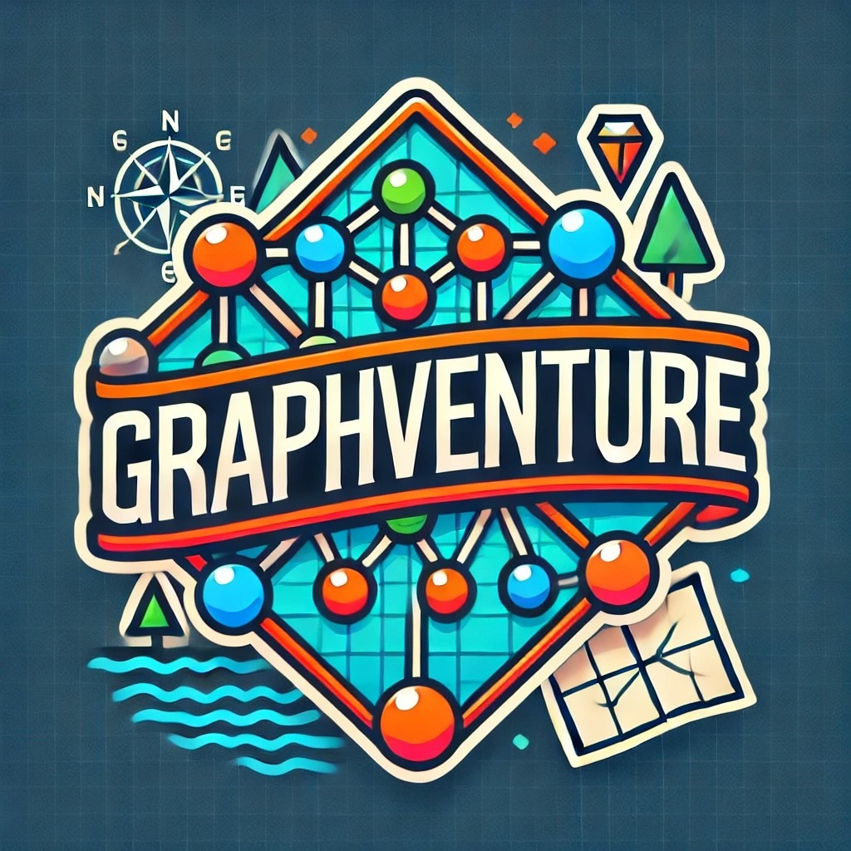
For that project we have made our YouTube channel
https://youtu.be/n5GoiRsQu9M?si=cwwKzqed-9dn1aXp A Video Link For Krushkal’s Algorithm
https://youtu.be/4CUpLqb_MPM?si=BV5pyRogROLW6Pgv A Video Link For Dijkstra’s Algorithm
Our Application Logo And YouTube Channel Logo

